Slide 1
Elegant optimization

Slide 2
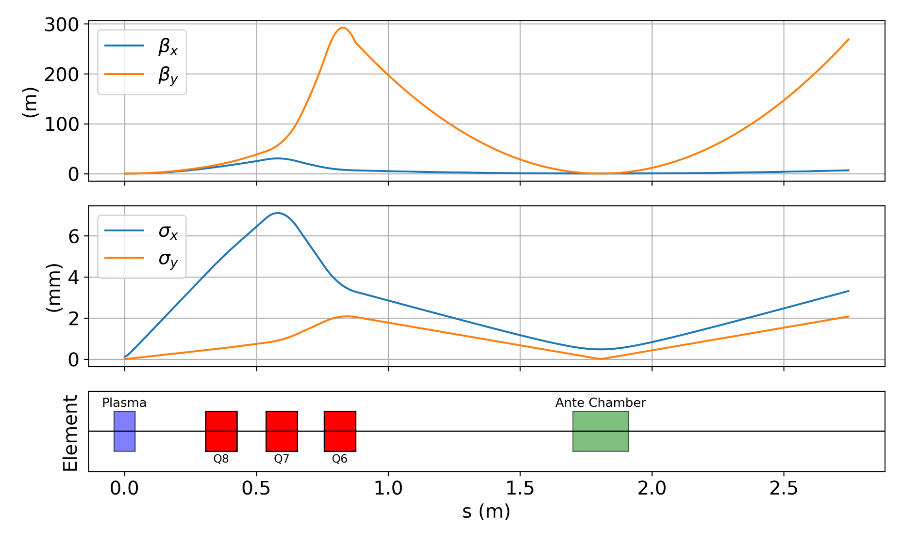

Run 1-2
Start from waist
Current Lattice (Changed D11 to 30 cm) : To make sure beta functions at quad are low
$β_{x}$(needed): 0.0092, $β_{y}$(needed): 0.0071
Constraints ($β_{x,max}$,$β_{y,max}:$ 39,300)
Optimizing quads and drift spacing
Small spot size at YAG
YAG

Slide 3
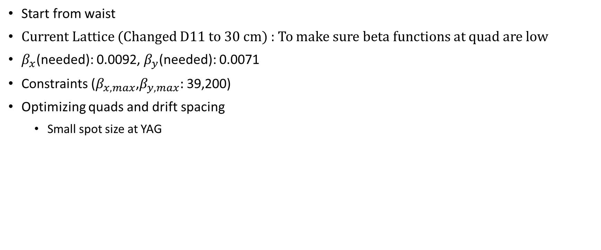

Run 3 – Constraining $β_{y}$ to 200
Start from waist
Current Lattice (Changed D11 to 30 cm) : To make sure beta functions at quad are low
$β_{x}$(needed): 0.0092, $β_{y}$(needed): 0.0071
Constraints ($β_{x,max}$,$β_{y,max}:$ 39,200)
Optimizing quads and drift spacing
Small spot size at YAG

Slide 4
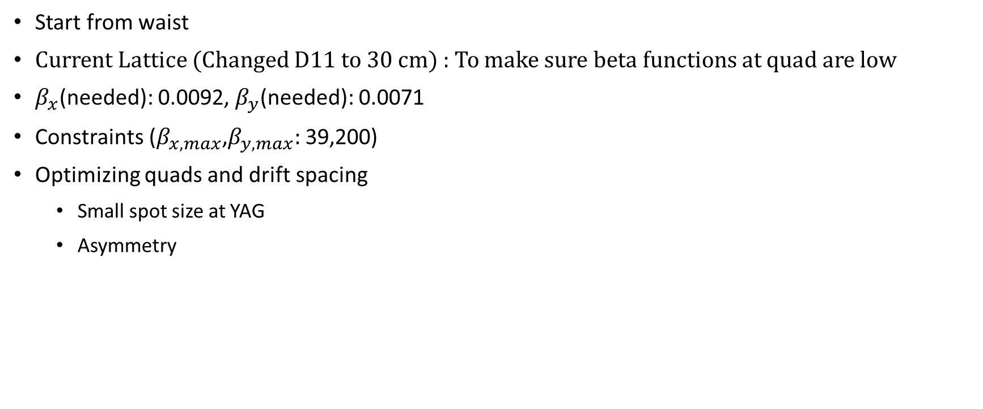
Run 4 – Asymmetry
Start from waist
Current Lattice (Changed D11 to 30 cm) : To make sure beta functions at quad are low
$β_{x}$(needed): 0.0092, $β_{y}$(needed): 0.0071
Constraints ($β_{x,max}$,$β_{y,max}:$ 39,200)
Optimizing quads and drift spacing
Small spot size at YAG
Asymmetry

Slide 5

Start from waist
Current Lattice (Changed last drift length)
$β_{x}$(needed): 0.009, $β_{y}$(needed): 0.0071
Optimizing quads
YAG
YAG
plasma

